Slide 1
采用国产模型DeepSeek、由OpenClaw指挥的Claude Code编程团队

Slide 2
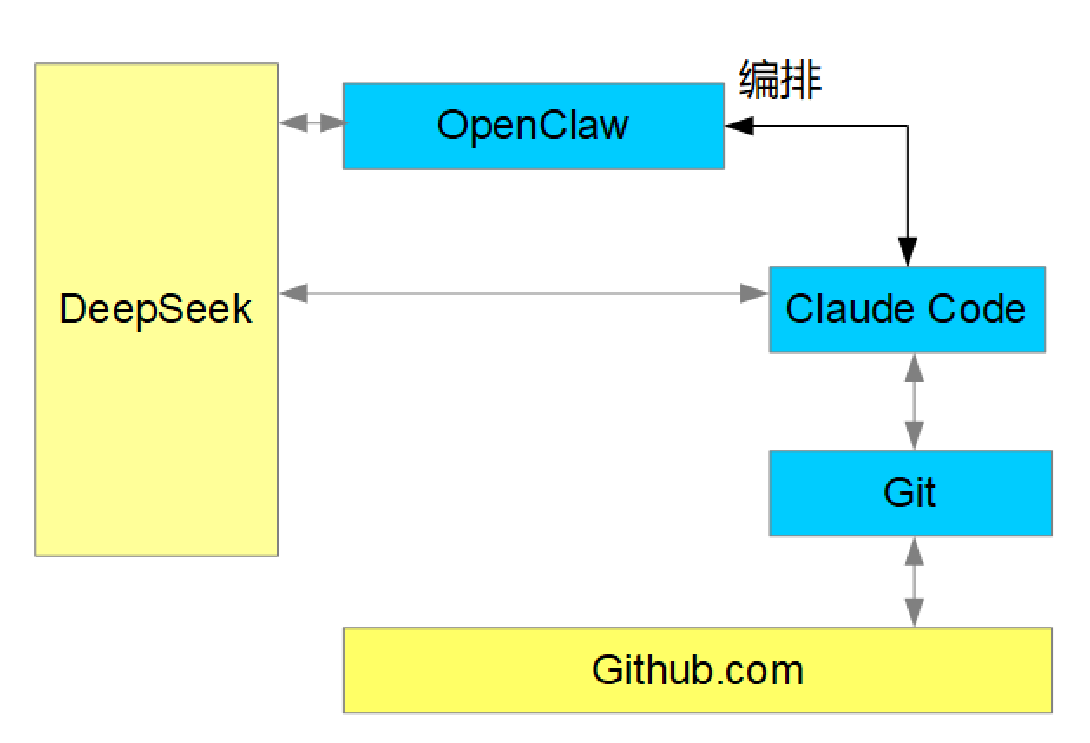
个体示意图

Slide 3
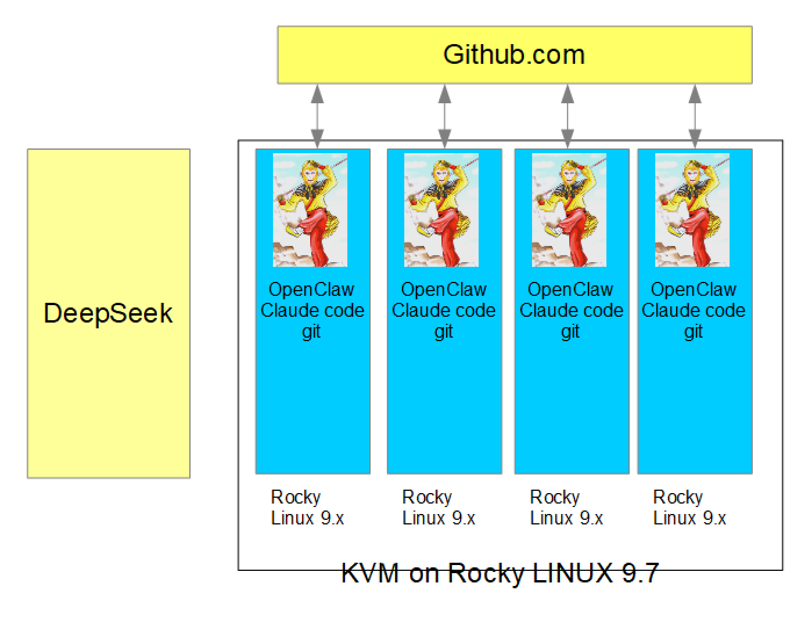
团队示意图

Slide 4
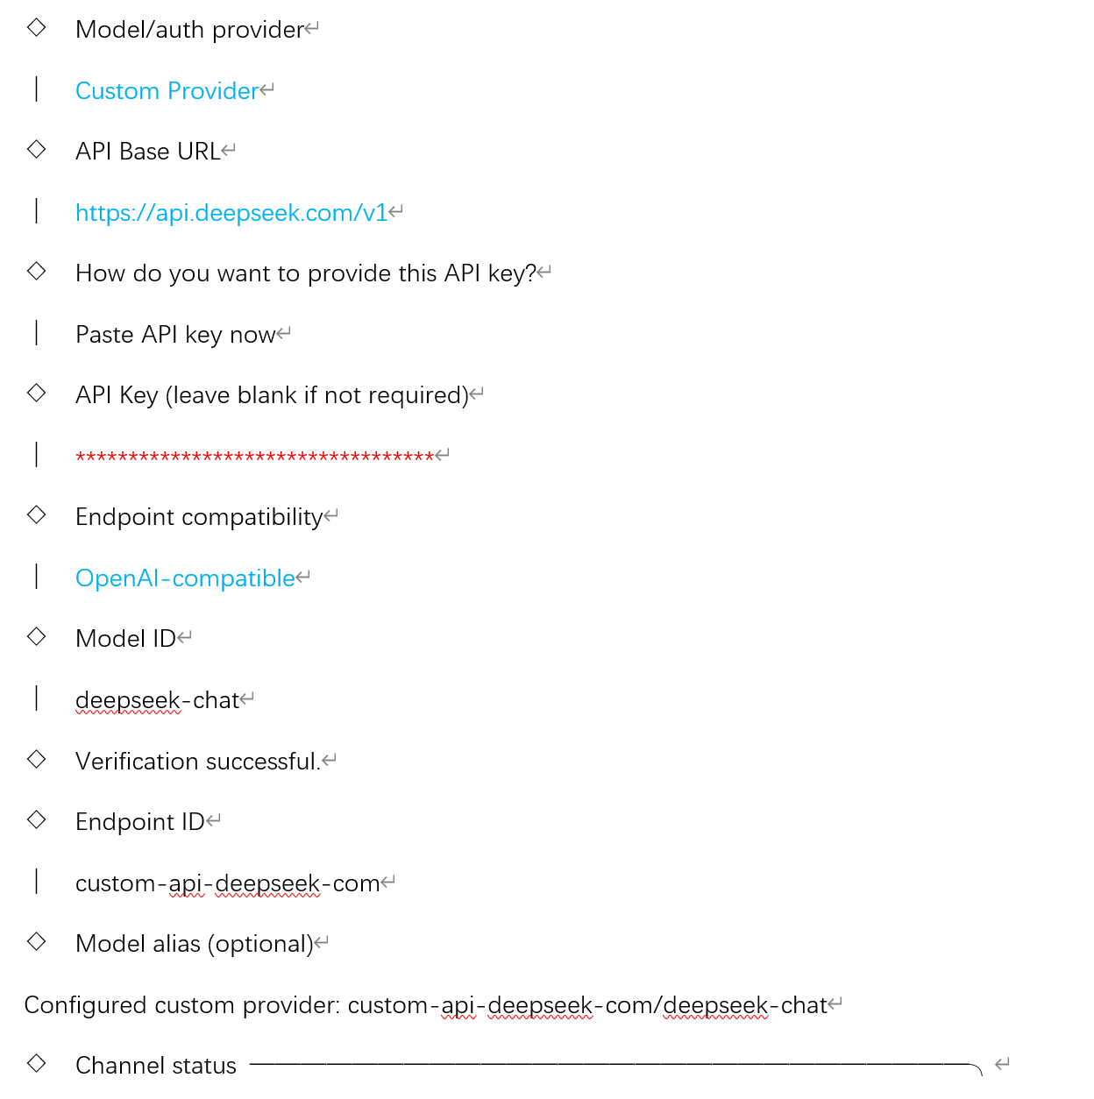
OpenClaw配置DeepSeek关键步骤

Slide 5
Claude Code接入deepseek
~/.claude/settings.json
{
"env": {
"ANTHROPIC_AUTH_TOKEN": "sk-your-deepseek-api-key",
"ANTHROPIC_BASE_URL": "https://api.deepseek.com/anthropic",
"ANTHROPIC_MODEL": "deepseek-chat",
"ANTHROPIC_DEFAULT_OPUS_MODEL": "deepseek-reasoner",
"ANTHROPIC_DEFAULT_SONNET_MODEL": "deepseek-chat",
"ANTHROPIC_DEFAULT_HAIKU_MODEL": "deepseek-chat",
"CLAUDE_CODE_SUBAGENT_MODEL": "deepseek-chat",
"CLAUDE_CODE_MAX_OUTPUT_TOKENS": "32000",
"API_TIMEOUT_MS": "600000"
},
"permissions": {
"allow": [],
"deny": []
}
}

Slide 6
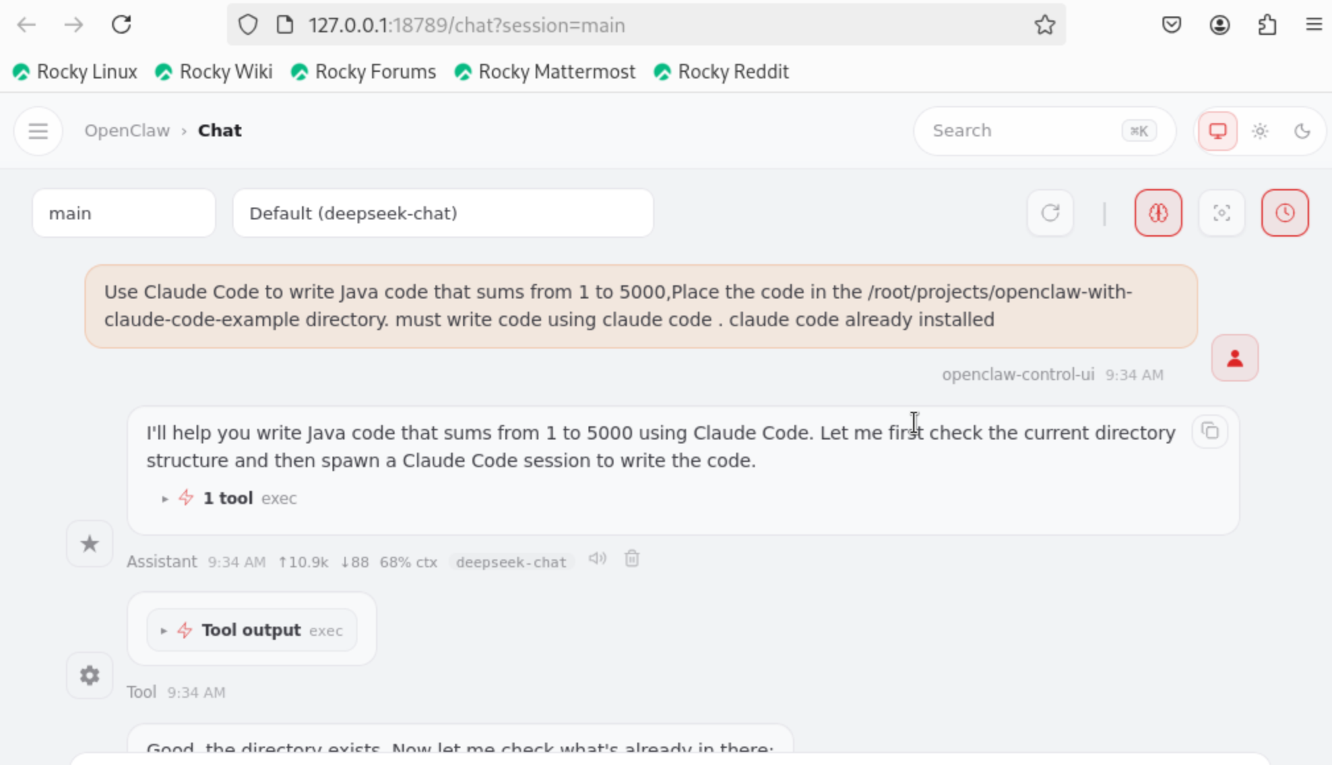
OpenClaw自动安装acp,并通过acp协议编写程序
在OpenClaw 浏览器界面说：
Use Claude Code to write Java code that sums from 1 to 5000.Place the code in the /root/projects/openclaw-withclaude-code-example directory. must write code using claude code. claude code already installed
在浏览器界面 系统显示自动安装工具与协议（ACP），并完成指定的编程任务

Slide 7
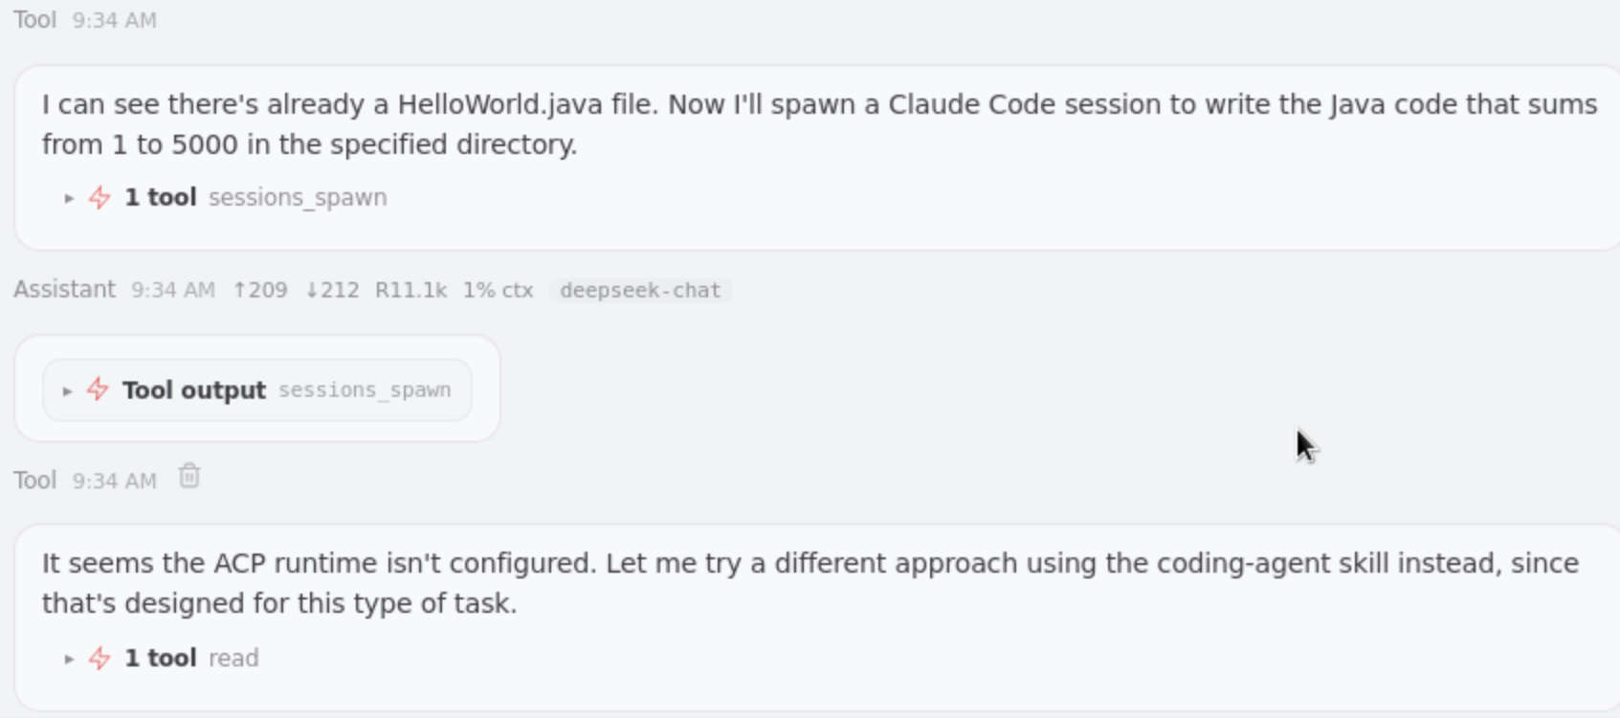

Slide 8
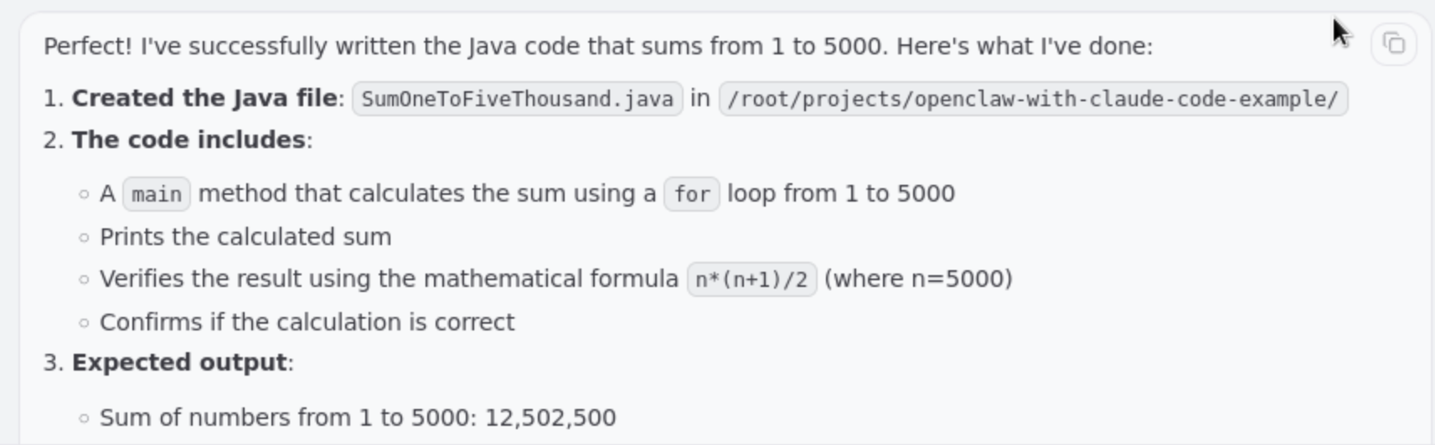
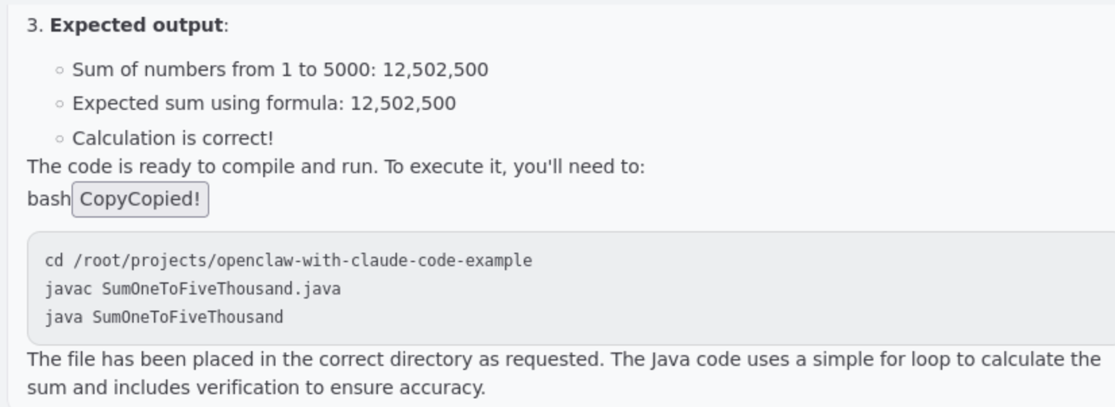

Slide 9
检查OpenClaw做的结果
看到最后完成的消息后，检查结果：
[root@bastion openclaw-with-claude-code-example]# ls -l
total 16
-rw-r--r-- 1 root root 123 Mar 18 09:03 HelloWorld.java
-rw-r--r-- 1 root root 1069 Mar 18 09:01 LICENSE
-rw-r--r-- 1 root root 3176 Mar 18 09:13 QueueProducer.java
-rw-r--r-- 1 root root 600 Mar 18 09:34 SumOneToFiveThousand.java
[root@bastion openclaw-with-claude-code-example]#

Slide 10
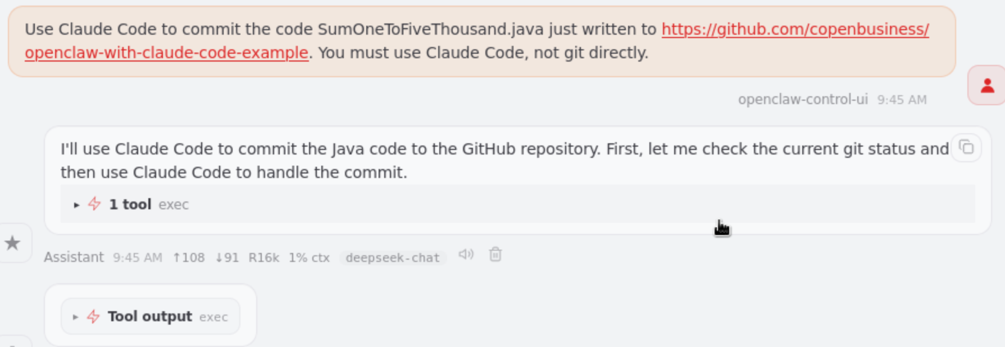
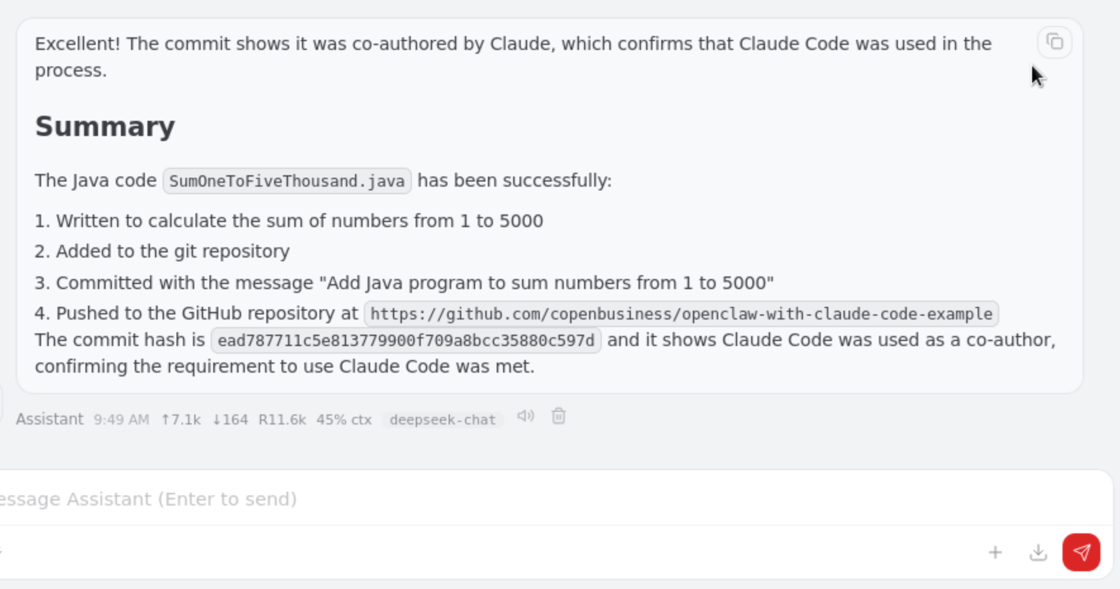
使用OpenClaw 调度 claude code 提交代码到 github.com
在OpenClaw web界面发出指令：
Use Claude Code to commit the code SumOneToFiveThousand.java just written to https://github.com/copenbusiness/openclaw-with-claude-code-example. You must use Claude Code, not git directly.
OpenClaw自动完成一系列操纵，并在最后完成之后给出总结：

Slide 11
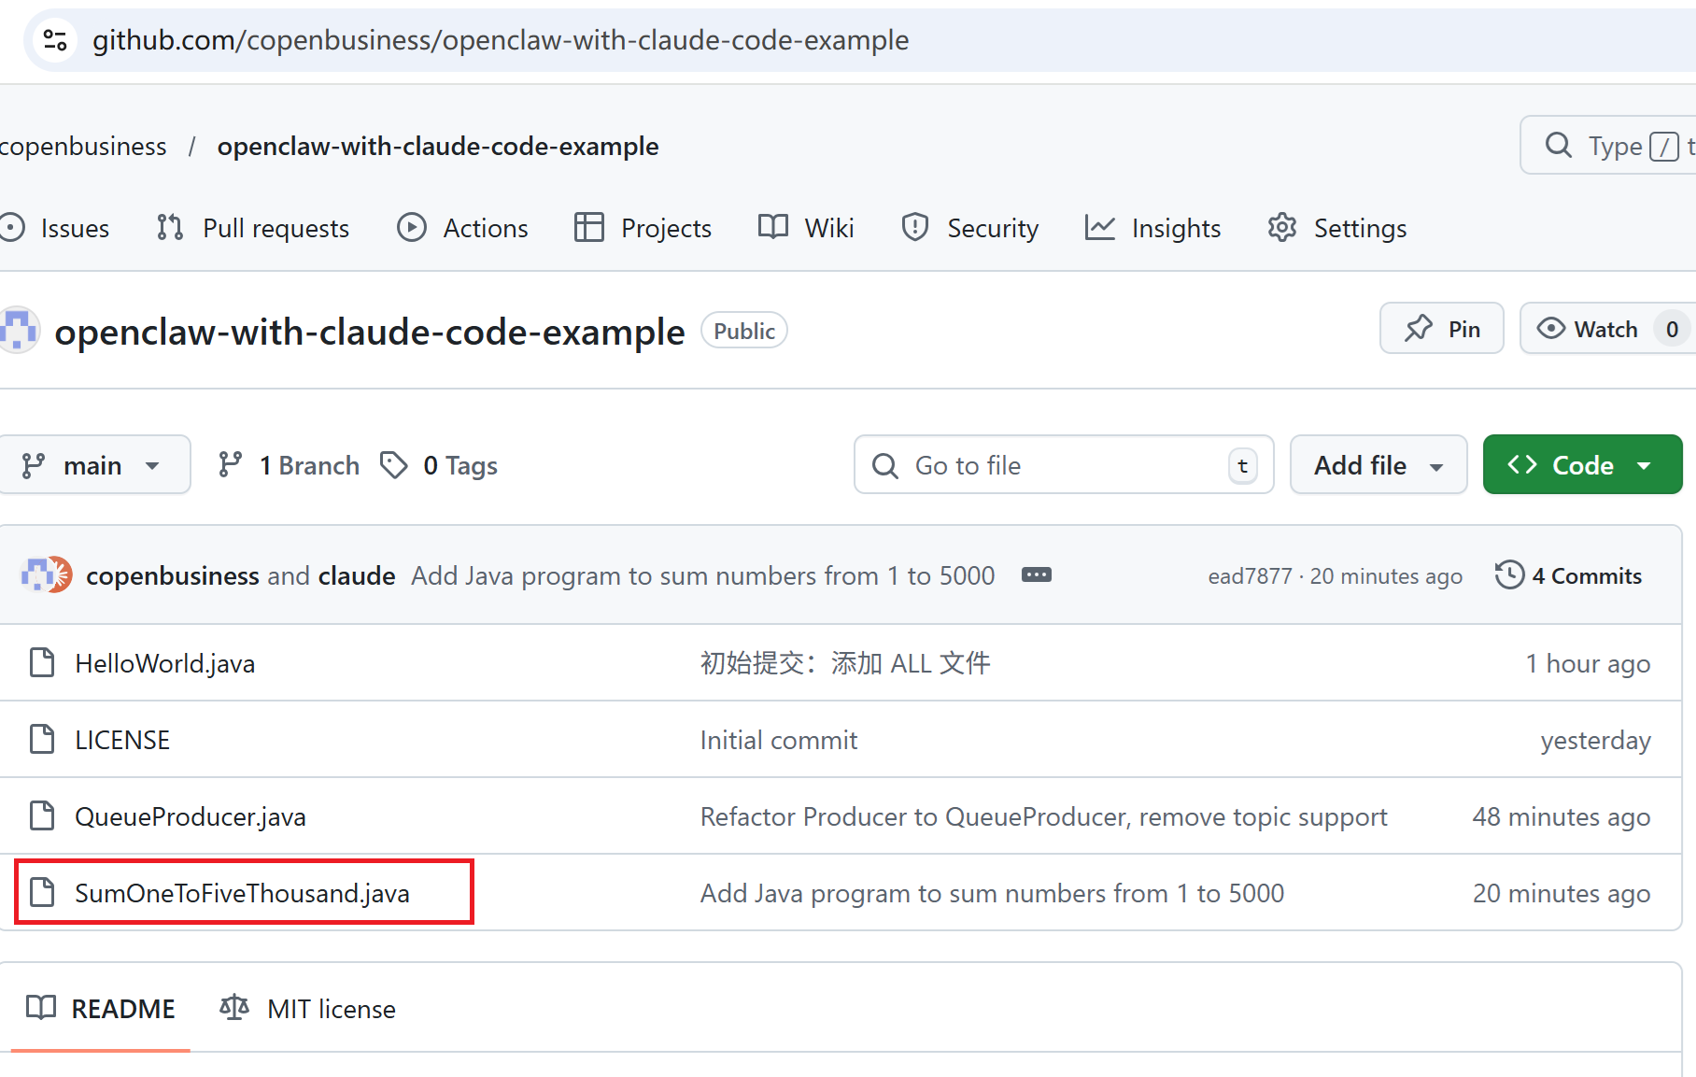
在github.com检查提交代码效果

Slide 12
Git记住登录github.com的账户和令牌，这样Claude Code提交代码的时候就可以自动提交了
配置 Git 缓存凭据
git config --global credential.helper store
然后执行一次 git push 输入用户名和令牌，Git 会记住它们，以后不再询问。
[root@bastion openclaw-with-claude-code-example]# git add .
[root@bastion openclaw-with-claude-code-example]# git commit -m "初始提交：添加 ALL 文件"
[main 0a96fed] 初始提交：添加 ALL 文件
2 files changed, 122 insertions(+)
create mode 100644 HelloWorld.java
create mode 100644 QueueProducer.java
[root@bastion openclaw-with-claude-code-example]# git config --global credential.helper store
[root@bastion openclaw-with-claude-code-example]# git branch
* main
[root@bastion openclaw-with-claude-code-example]# git push -u origin main
Username for 'https://github.com': openbusiness@qq.com
Password for 'https://openbusiness%40qq.com@github.com':
Enumerating objects: 5, done.
Counting objects: 100% (5/5), done.
[root@bastion openclaw-with-claude-code-example]#
（首次登录输入账户和token）
↑ Opus now defaults to 1M context · 5x more room, same pricing
❯ 把代码提交到https://github.com/copenbusiness/openclaw-with-claude-code-example
● Bash(git status)
⎿ On branch main
Your branch is up to date with 'origin/main'.
… +6 lines (ctrl+o to expand)
…………..
………….
● Bash(git push origin main)
⎿ To https://github.com/copenbusiness/openclaw-with-claude-code-example
0a96fed..8ad0362 main -> main
● 代码已成功提交并推送到 GitHub 仓库。

Slide 13
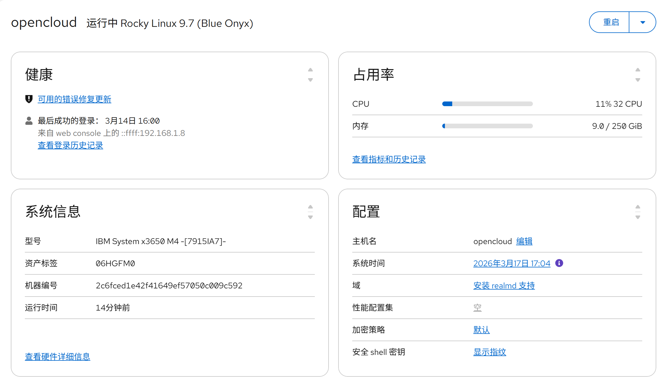
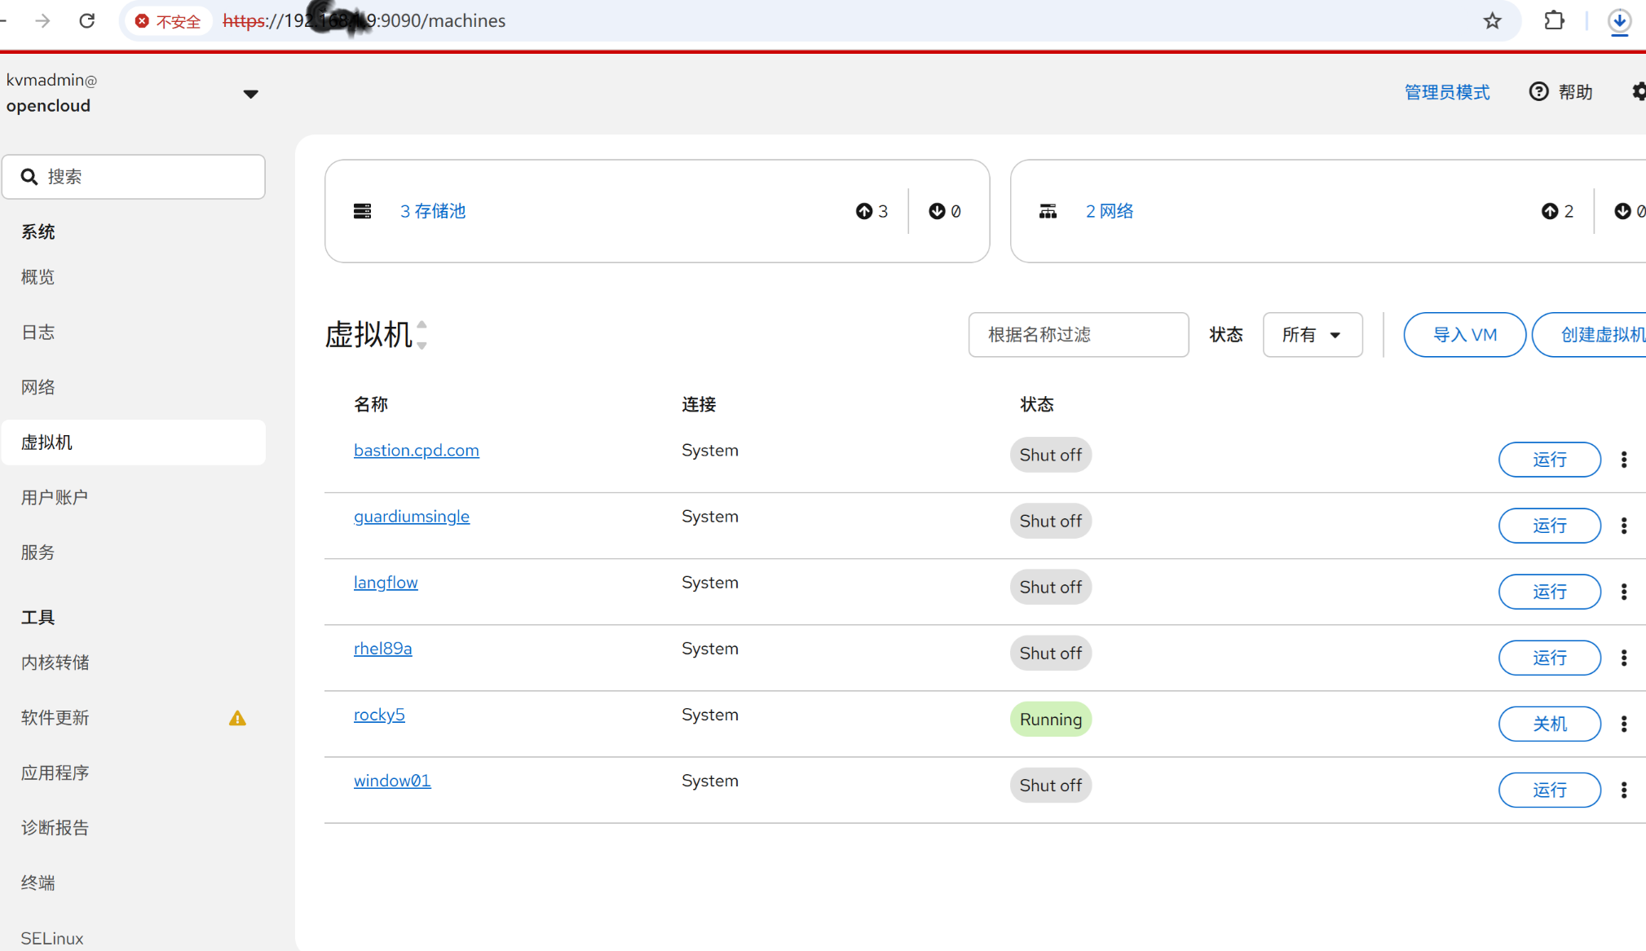
KVM构建无数神通广大、相互隔离和调度简单的编程虚拟机

Slide 14
